Slide 1

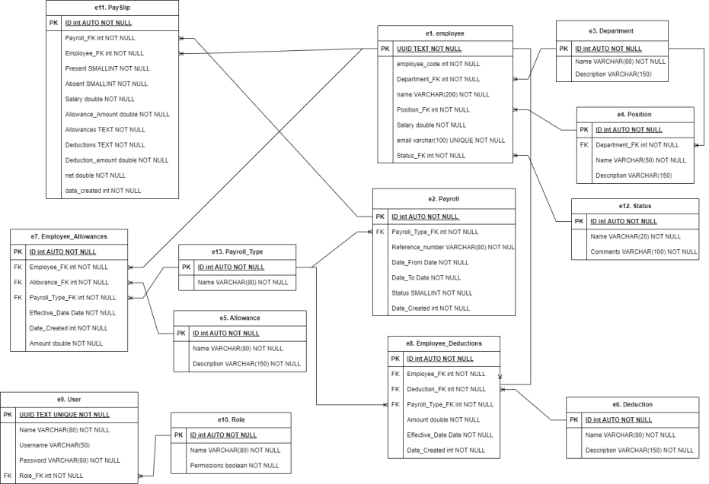

Payroll Management System for Trimeca S.A Company
Adiel Valentin Hernandez, Nicolás Guevara Herrán, School of Systems Engineering Universidad Distrital Francisco José de Caldas, Bogotá, Colombia
Company Trimeca S.A has raised the need for monetary compensation for the hours not given to employees though monetary payments corresponding to individual salary assignments. Adding into it, the company is in need to organize each employees' allowances, since they are not certain how are these allowances being managed, as well as the employees' deductions.
We managed to design an ERM which consists of 14 entities.
INTRODUCTION
RESULTS
For this first phase, in order to get the solution of the problem given before, we need to design a database that can handle and organize all the information needed
GOAL
ABOUT TRIMECA S.A
TECHNICAL OBSERVATIONS
• We decided to make the ID from Users and Employees an UUID, in order to make it safer.
• In some places, we decided to use SMALLINT variable type.
• Since the salary may change between employees at the same position, we decided to make it an attribute of employees' table.

